Slide 1
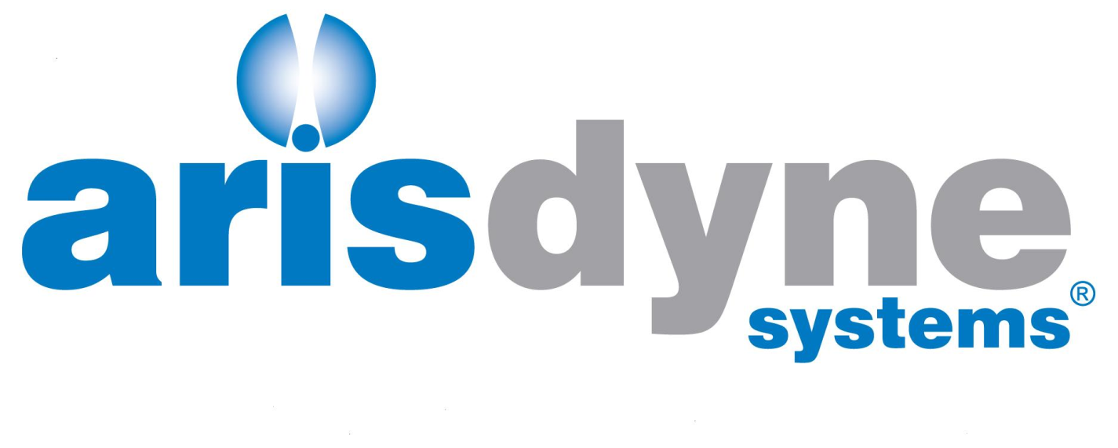
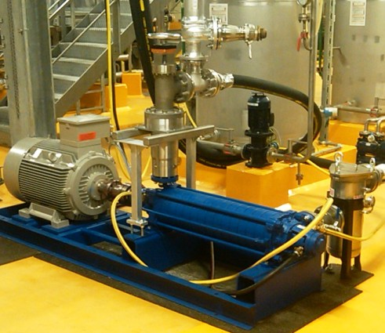
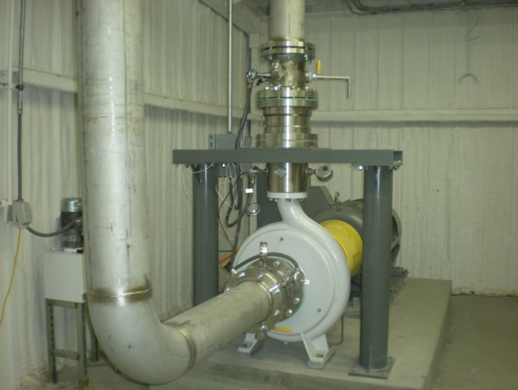
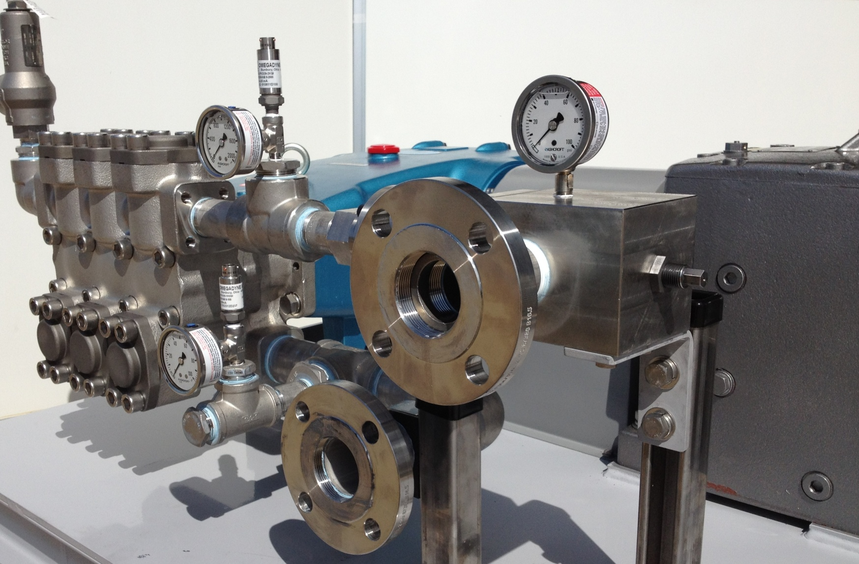
Digestion Enhancement Pre-Treatment with CFC™
WEF,
New York,
August 2015

Slide 2
Arisdyne Overview
Headquartered in Cleveland, founded in 2008
Mission: applying cavitation technology to improve economics of industrial processes
Core technology: Controlled Flow Cavitation (CFC™) produces powerful shock waves, ultra-high shear forces, high-temperature “hot spots”
Inventor and Arisdyne CTO, Dr. Oleg Kozyuk, pioneering scientist
Strong portfolio of 30+ global patent families protects CFC™ technology
De-agglomeration/particle size management
Ethanol
Waste Water Treatment
Superior mixing/Emulsions/Dispersions
BioDiesel and Veg Oil refining
“hot spots”
Partial upgrading of heavy oils

Slide 3

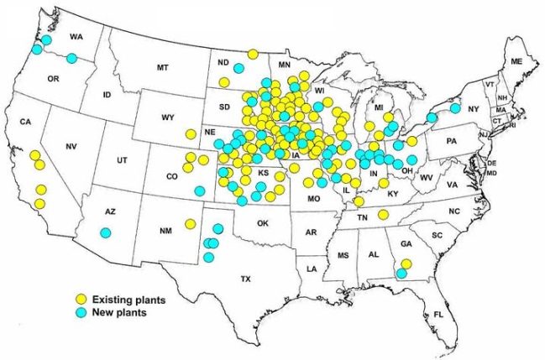
Arisdyne
Cleveland based company
Controlled flow hydrodynamic cavitation (CFC™)
Applications in various industries:
Deagglomeration/particle size management
Ethanol
Waste Water Treatment
Superior mixing/Emulsions/Dispersions
BioDiesel and Degumming
Conductive inks

Slide 4
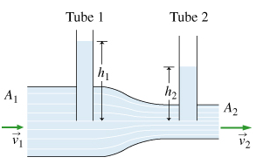
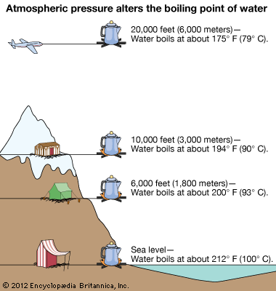
Hydrodynamic Cavitation
Increase of speed leads to pressure reduction
Reduced pressure leads to evaporation and vapor bubbles
Notes:
4

Slide 5
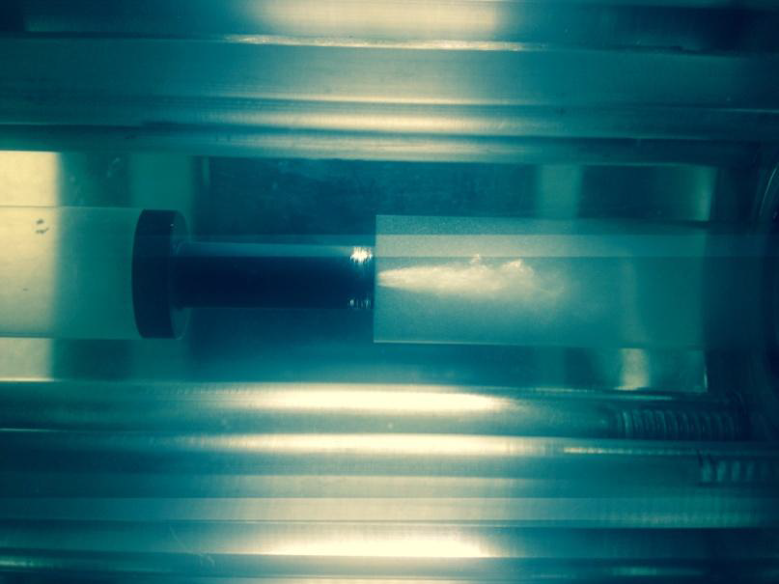
Hydrodynamic Cavitation
Notes:
5

Slide 6
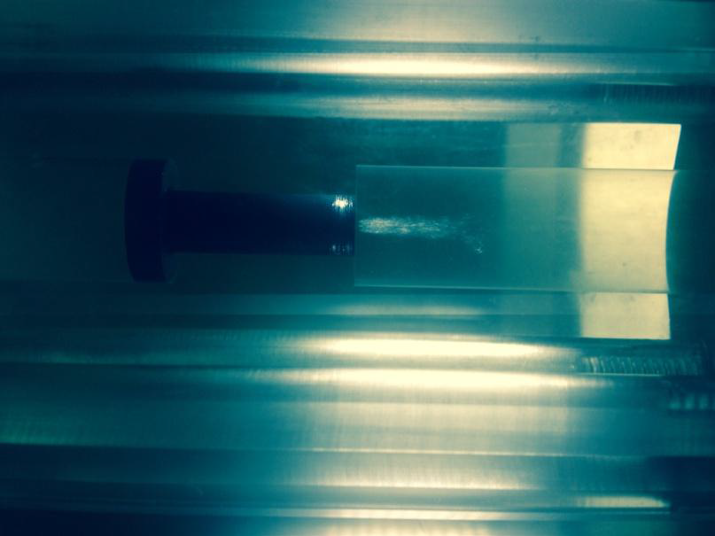
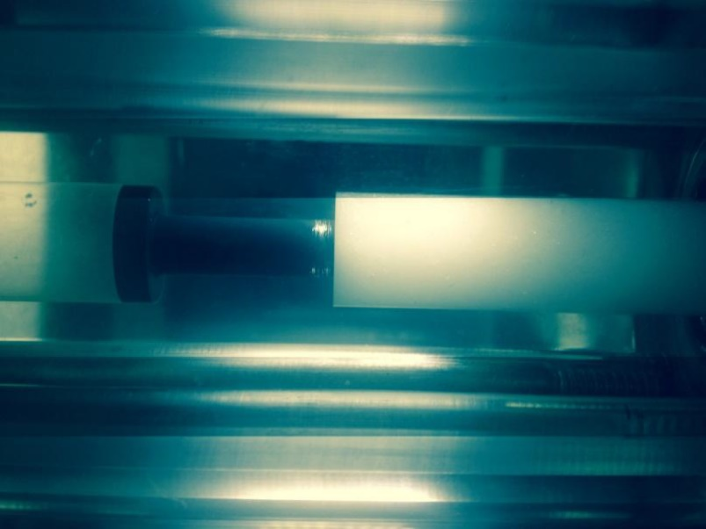
CFC™- extreme energy peak
controlled bubble collapse – energy dissipation in small volume
extreme energy peak
uncontrolled bubble collapse

Slide 7

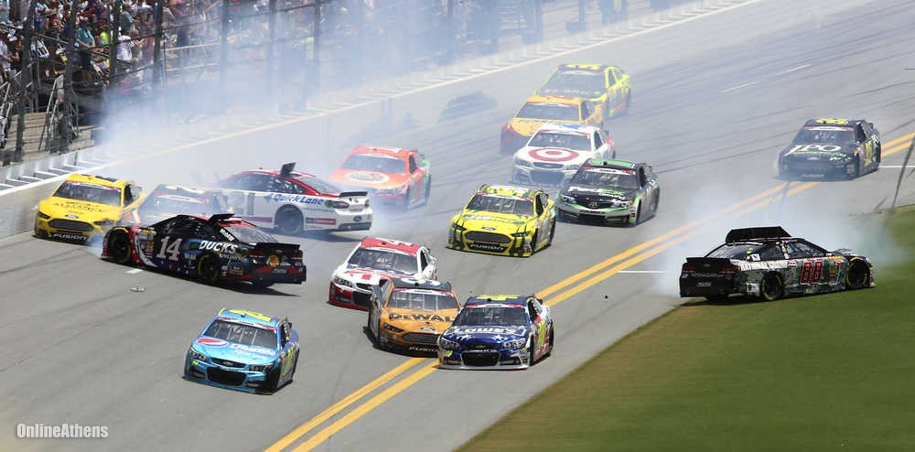

CFC™- extreme energy peak
Sudden collapse – “extreme energy peak”
“lucky guy”

Slide 8
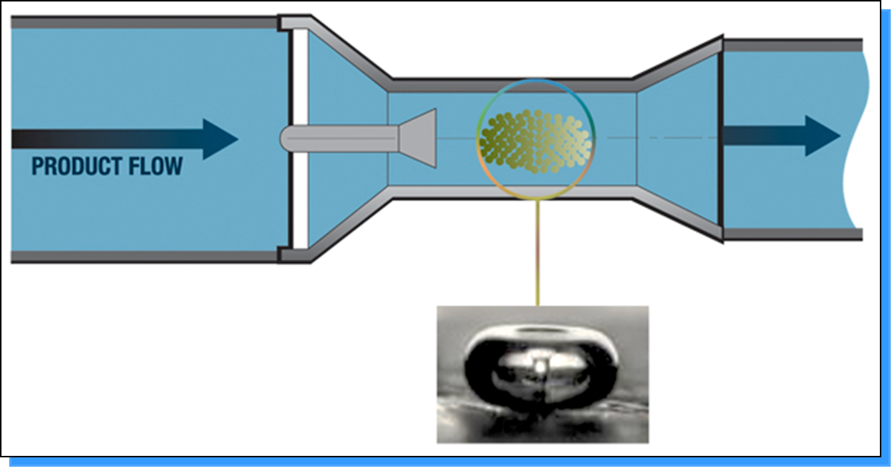
Overview of CFC™

Slide 9
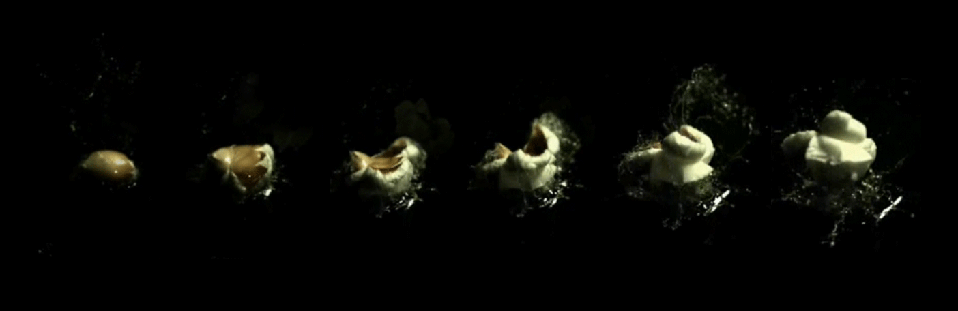
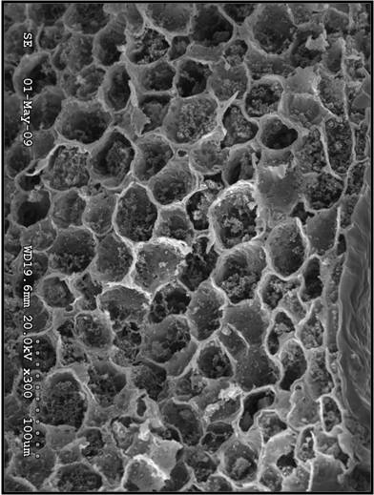
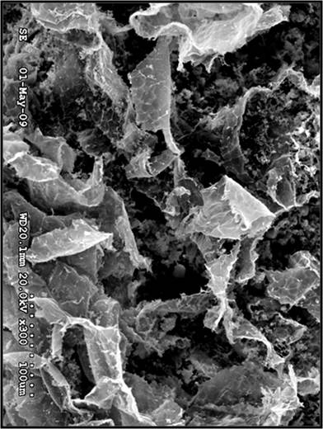
“CFC™- Popcorn-Effect”
CFC™ creates low pressure zones, where corn kernel cell wall structure explode (“popcorn effect”) followed by the shock wave, which reduces particle size.

Slide 10
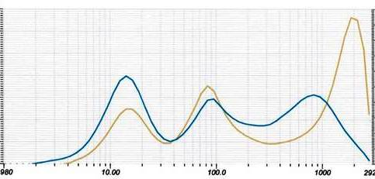
Particle Size Reduction

Slide 11
Current Problem and Paradigm
WWTP operation will cost even more in future
energy costs
costs for treating and handling sludge
stringent regulation of sludge use for agriculture
fuel/ transportation costs
limitations of landfill operations
Current anaerobic-digestion-improving technologies
increase biogas yield and as such produce more energy and decrease the mass of solids for disposal, but
are capex and opex intensive

Slide 12
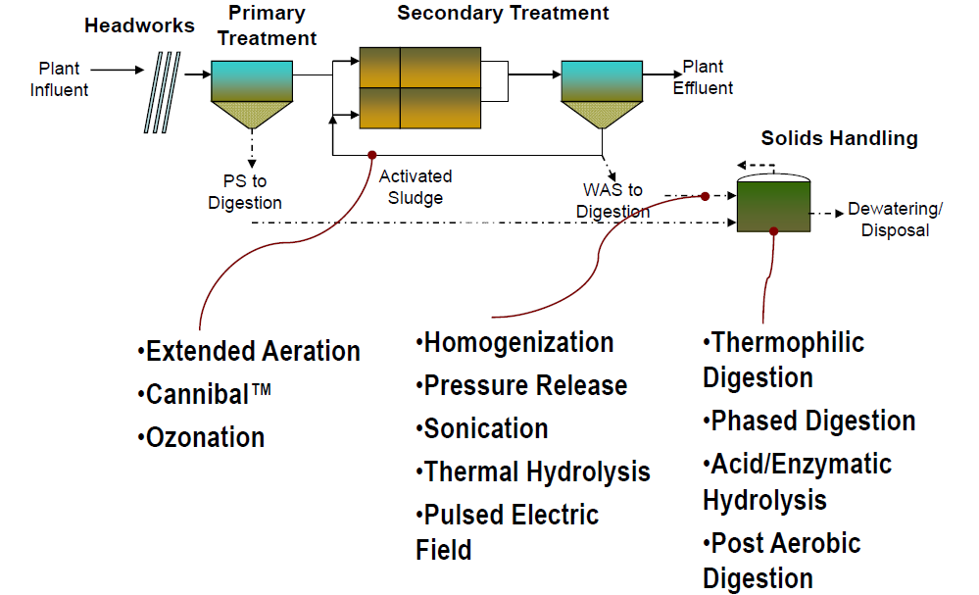
Current Biosolids Minimization Technologies
CFC™
Source: Dru Whitlock, 2010 WEF Residuals and Biosolids Conference – Session 10

Slide 13
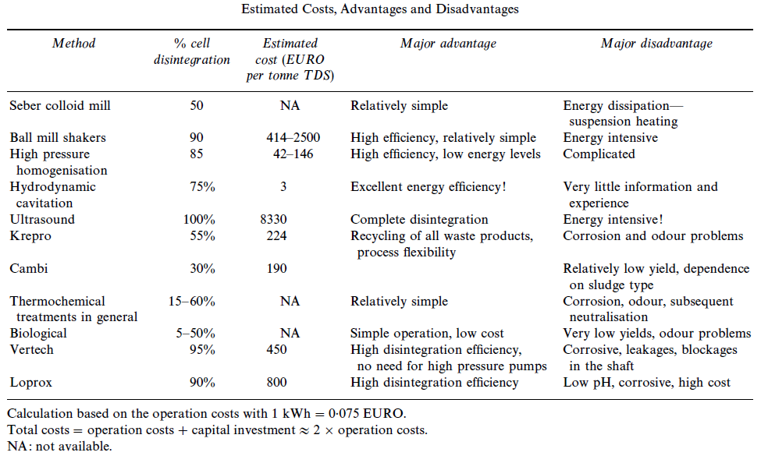
Evaluation of Wet Sludge Disintegration Techniques
Source: Marjoleine Weemaes & Willy Verstraete, Centre for Environmental Sanitation, University Ghent, Belgium, 1998

Slide 14
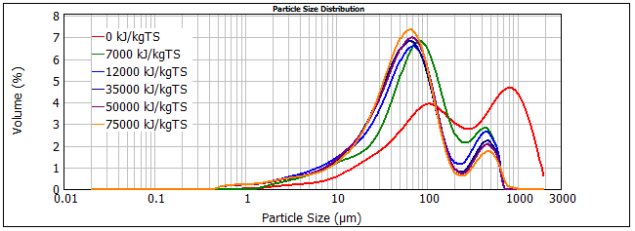
Cavitation Ultrasound Cavitation
Source: www.ipcbee.com/vol42/017-ICBEM2012-C00007.pdf‎‎
Effect of External Pressure on the Efficacy of Ultrasonic Pretreatment of Sludge
Ngoc Tuan LE, Berthe RATSIMBA, Carine JULCOUR-LEBIGUE and Henri DELMAS
Université de Toulouse, Laboratoire de Génie Chimique, INP-ENSIACET, 31030 Toulouse, France

Slide 15
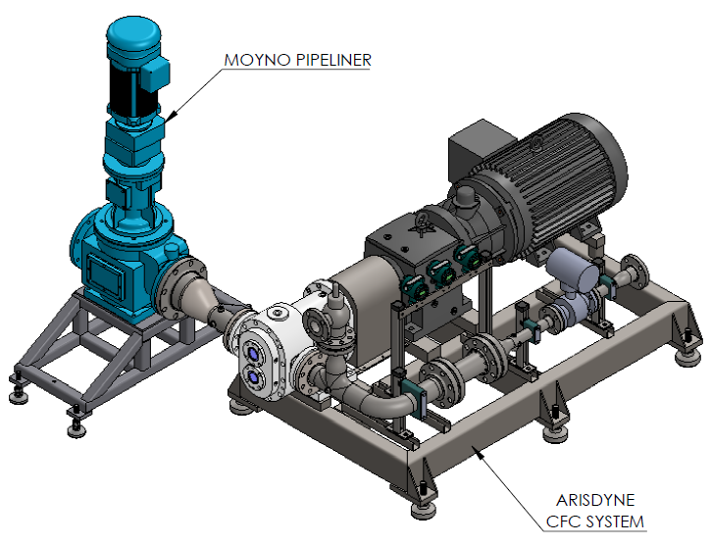
Real Retrofit:
compact, elegant and efficient
5 ft
8 ft

Slide 16
Cost Comparison / OPEX
Source: THE ECONOMICS OF ADVANCED DIGESTION; Jolly, M. and Gillard, J; Black & Veatch, UK
⁽¹⁾ Arisdyne’s pilot tests

Slide 17
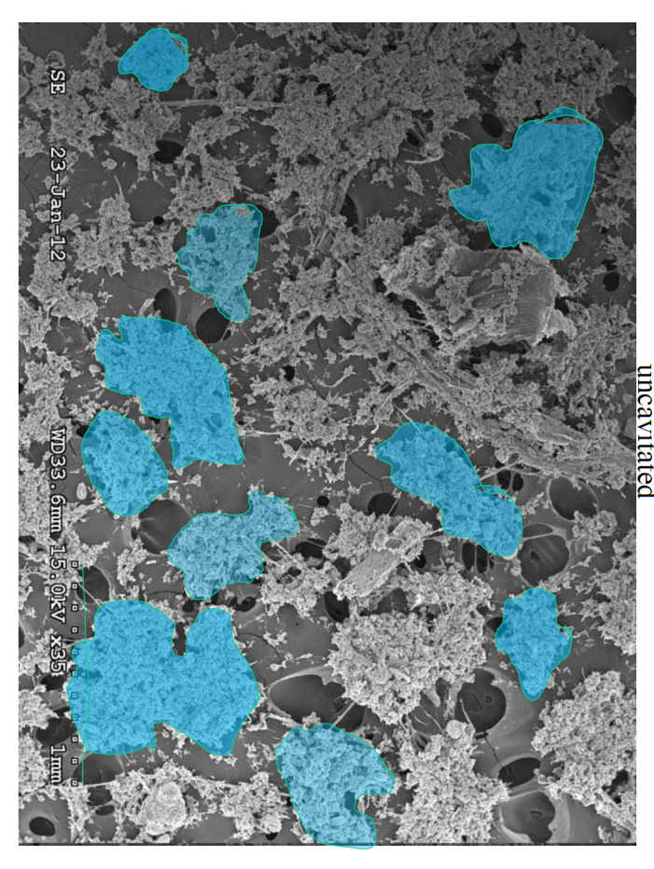
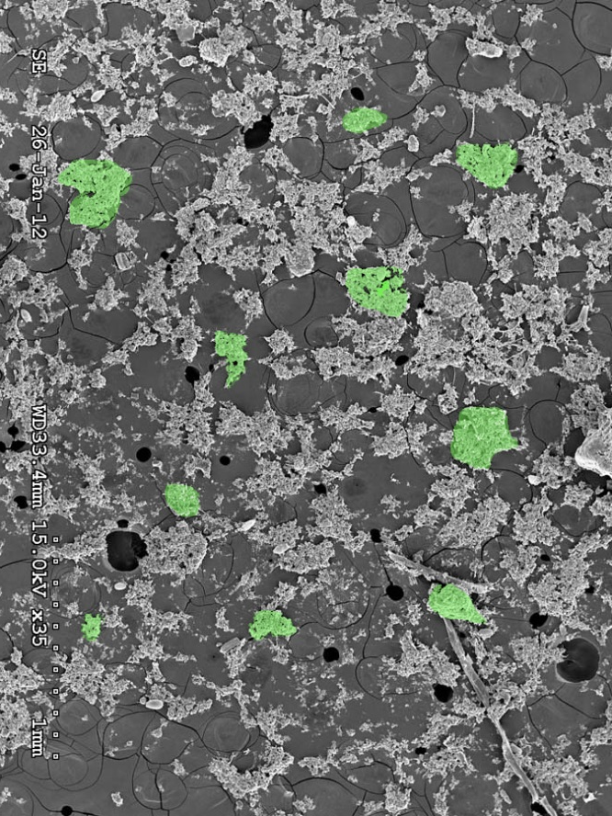

Particle Size – Example WWTP
Shift in particle size
Destroy structure of cells
Lyses cells
Destroy flocculants and agglomerates
Pre Cavitation
Post Cavitation
Confirmed Source: Ohio State Study [OARDC, Fred Michel]

Slide 18
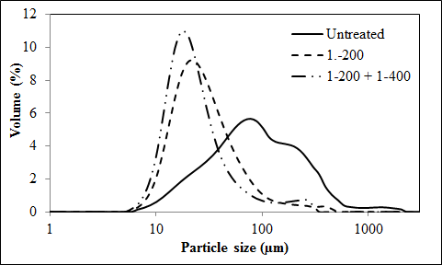
Particle Size Shift CFCTM
Confirmed Source: Ohio State Study [OARDC, Fred Michel]

Slide 19
Increased Gas Production Over 30 Days
Percentage Increase Over Control
HOURS

Slide 20
Conclusion
More fermentable sugars through the breakdown of cellulose by improving cellulase activity
Real retrofit –
Small footprint and durable

Slide 21
Thank you!
Contact:
Peter Reimers
Cell: 2167895060
Office: 216 458 1991 ext 450
Email: preimers@arisdyne.com
www.arisdyne.com

Slide 22
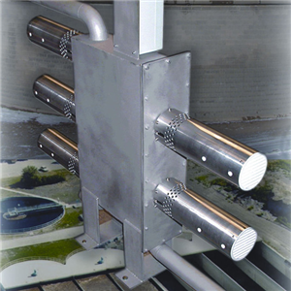
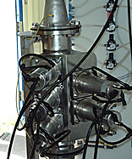
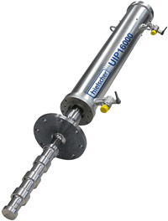
Cavitation Ultrasound Cavitation
Ultrawaves, OVIVO; Sonolyzer™
Sonico; sonix™
Hielscher
Difficult to scale-up
Inhomogeneous bubble distribution
Erosion to equipment
Inefficient on industrial scale

Slide 23
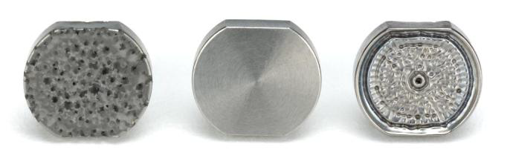
Cavitation CAVITATION EROSION OF ULTRASONIC PROBES
Source: www.sonics.com/liquid-datasheet/CAVITATION%20EROSION%20OF%20ULTRASONIC%20PROBES.pdf

Slide 24
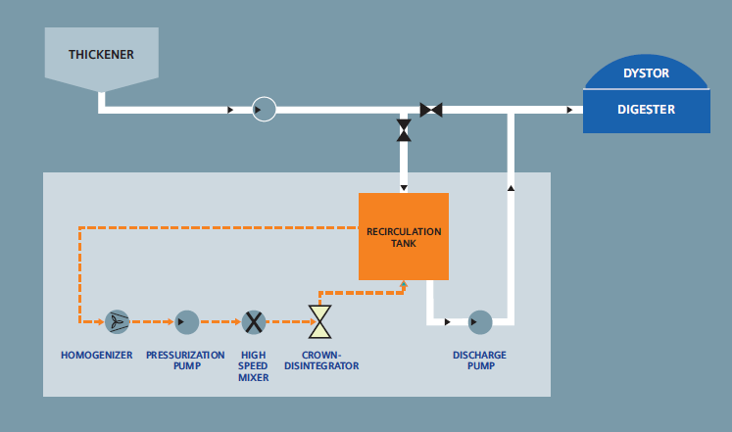
Cavitation Uncontrolled Hydrodynamic Cavitation
Source: www.water.siemens.com/.../Product_Lines/.../EN-CROWN-BR-0510.pdf‎

Slide 25
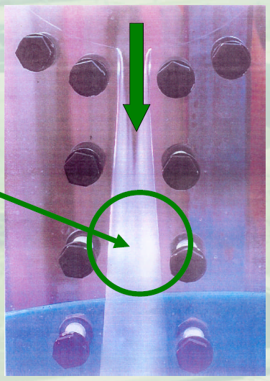
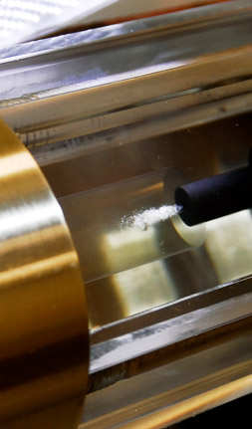
Cavitation Uncontrolled vs. Controlled Hydrodynamic Cavitation
“Carefully Controlled Cavitation”
Controlled Cavitation
Crown disintegration system
Arisdyne, CFCTM
Highest energy peak
No cavitational erosion on CFC™ equipment
Sources:
www.tnav.be/documents/BiogestWSkosten.pdf‎
www.arisdyne.com/vp/cavitation.htm ‎

